Slide 1
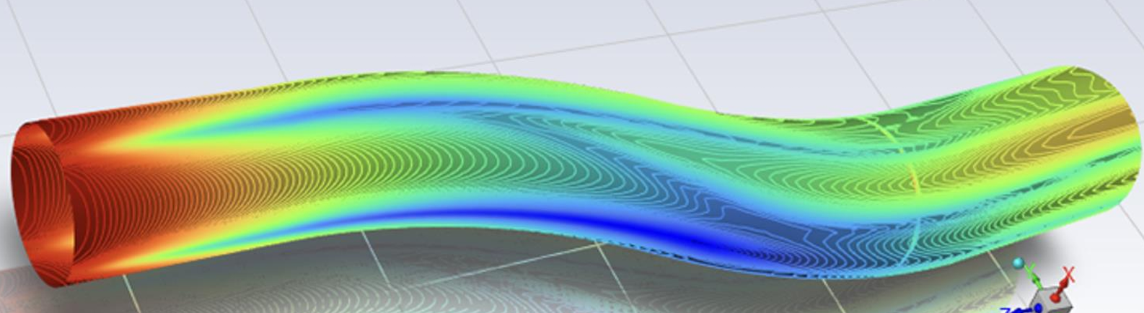
Comparing and Predicting S-Duct Performance with CFD and AI Model

Slide 2
Content
Introduction
Objective
Website Overview
Key Features
Circle-circle s-ducts in commercial aircraft
Square-circle s-ducts in commercial aircraft
Conclusions

Slide 3
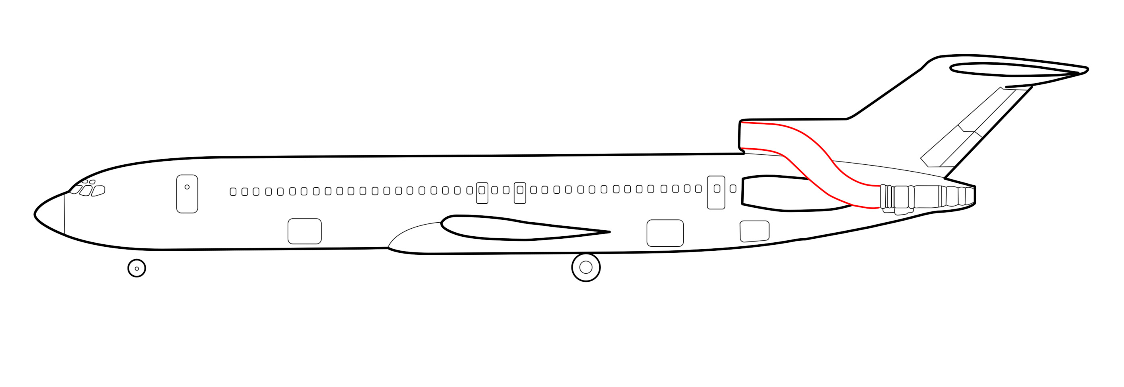
Introduction
An S-duct ( serpentine inlet), is a specialized
duct used in aircraft and high-performance
vehicles to efficiently manage airflow.
Key Features:
The S-shaped pathway ensures smooth airflow through bends, reducing turbulence.
S-ducts improves stability by managing airflow around the planes.
Curved walls can guide radar waves into radar-absorbent materials (RAM), reducing reflected energy.

Slide 4
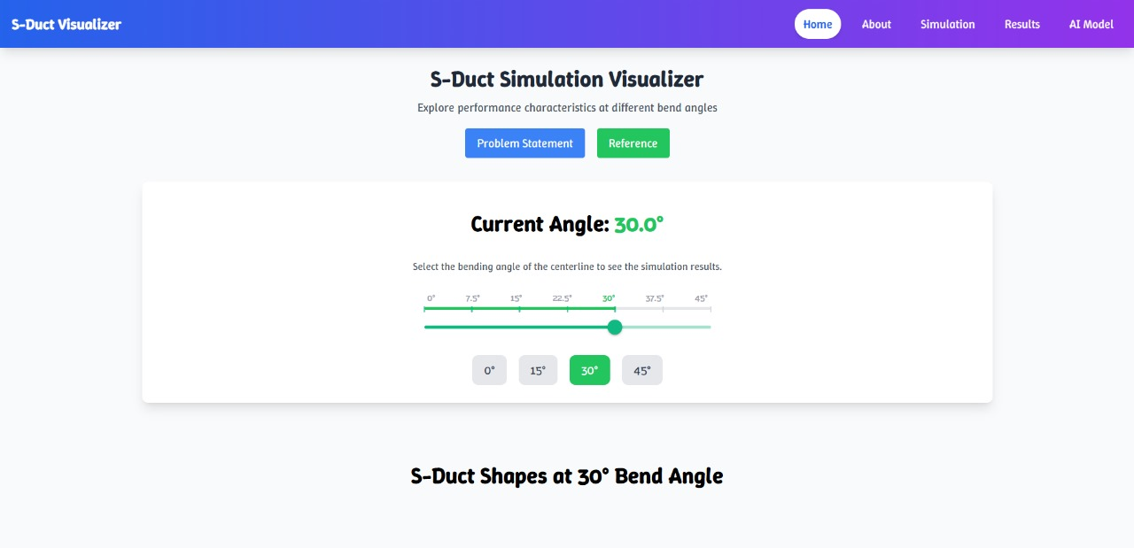
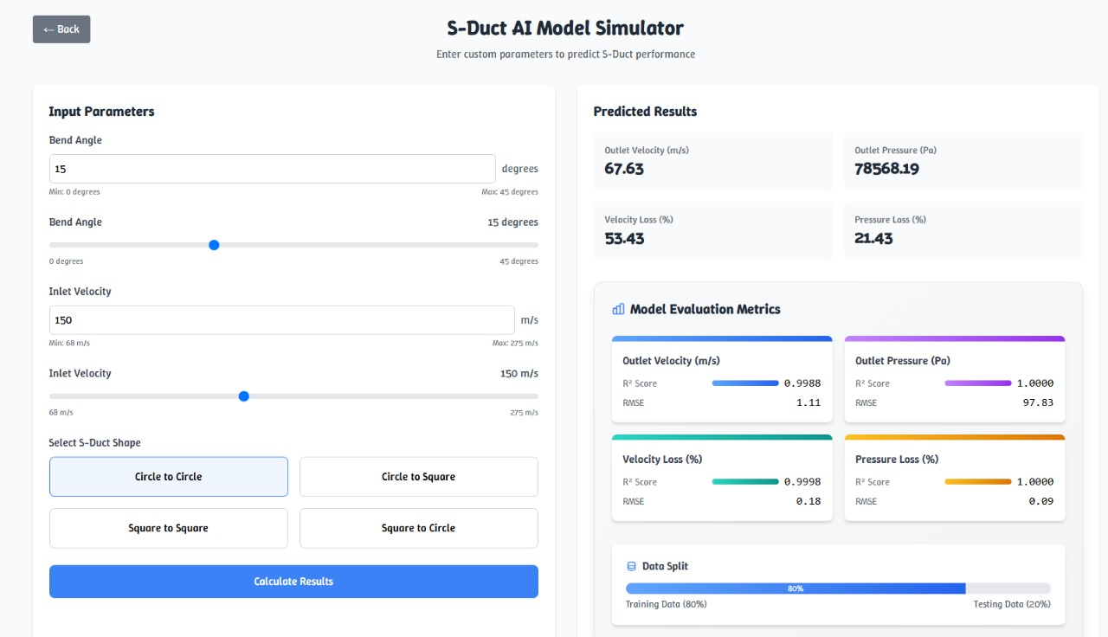
Objective
To develop an interactive web platform showcasing aerodynamic analysis of 28 S-duct geometries (4 cross-sections × 7 angles) at Mach 0.6, enabling users to compare outlet velocity, outlet pressure, and centerline velocity across designs. Additionally, we have integrated an AI model that predicts outlet velocity and pressure for any given input velocity and angle.

Slide 5
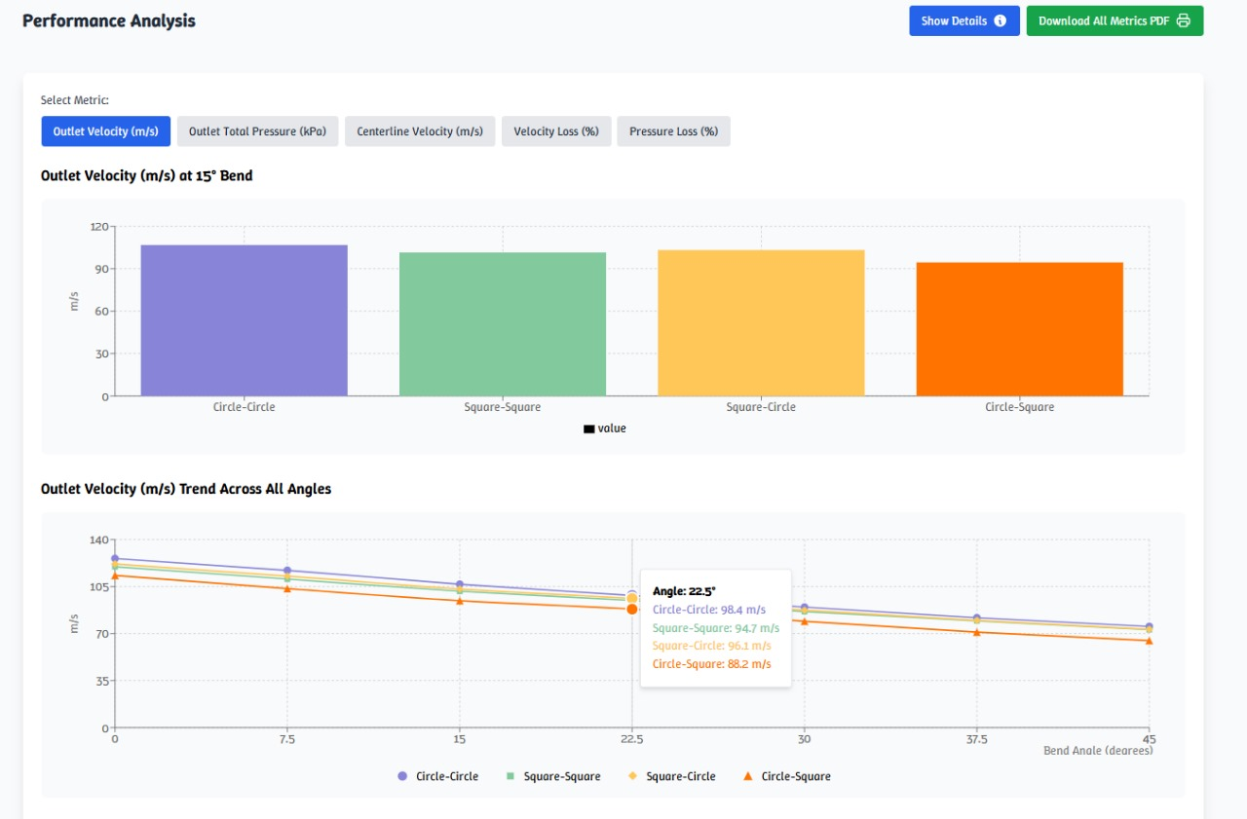
Website Overview
Aim of the Website
A Web platform to compare S-Ducts with different
cross-sections at varying angles (0° to 45°).
Helps visualize and analyze aerodynamic performance
for efficient design evaluation.
CFD Simulation
Evaluates four S-Duct cross-sections: Circle-to-Circle,
Square-to-Square, Circle-to-Square, and Square-to-Circle.
Compares key parameters like outlet velocity, outlet pressure, centerline velocity, and pressure loss.
Web Development
Built using React.js for an interactive and dynamic user experience.
Integrates data visualization for easy performance comparison across different configurations.

Slide 6
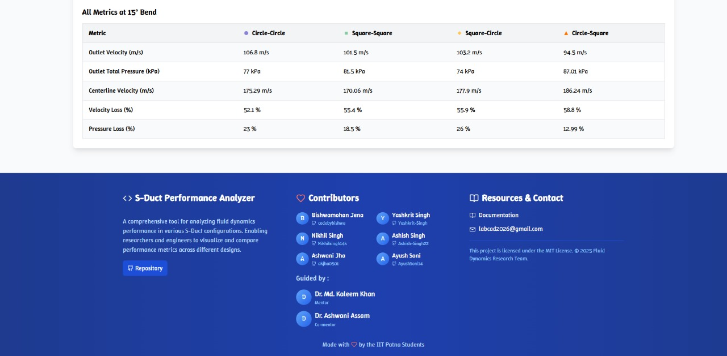
Website Key Features
Angle Selector
CFD Simulation Details
Performance Analysis
Metric Descriptions
Report Download
AI Predictor

Slide 7
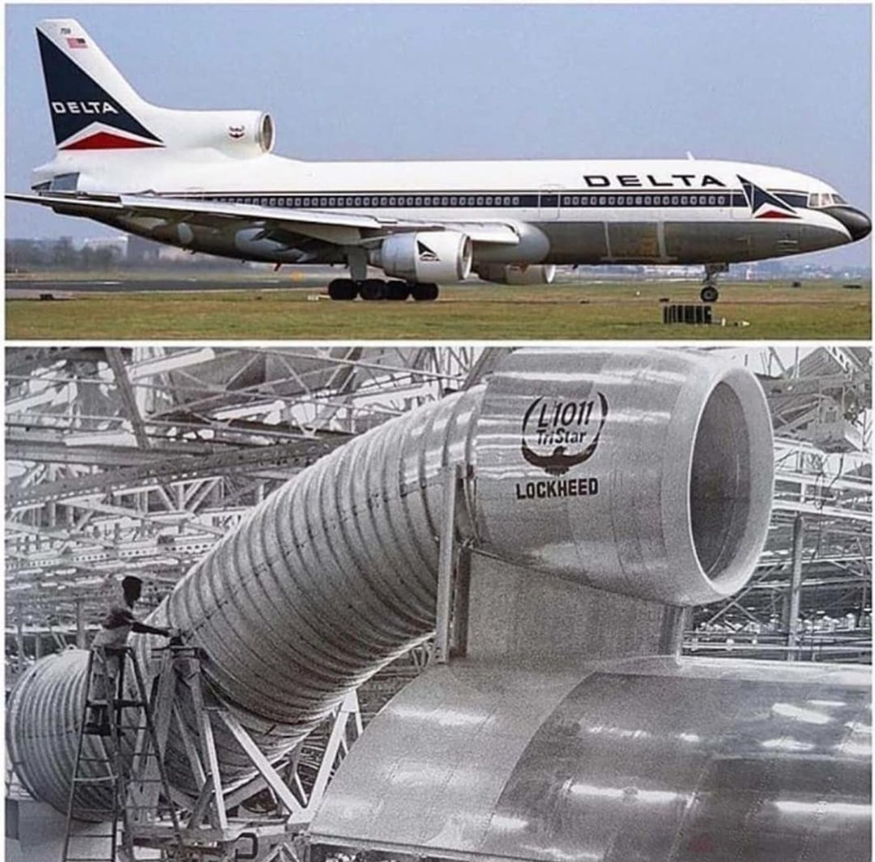
Circle–Circle S-Ducts in Commercial Aircraft
Higher Pressure Recovery: Circular cross-sections have better flow behavior. The shape allows the boundary layer to remain more stable, reducing flow separation and improving pressure recovery — which is critical for engine performance and fuel efficiency in commercial aviation.
Symmetric Flow Distribution: A circular inlet ensures smoother, more symmetric airflow into the engine. This reduces distortion and improves fan blade loading, which is essential for long-haul reliability.
Low Flow Distortion: Since commercial aircraft prioritize engine efficiency and performance over stealth, circle–circle S-ducts are designed to minimize distortion at the engine face and maximize pressure recovery.
Less Concern with RCS: Commercial aircraft don’t have stealth requirements, so RCS is not a factor in their intake design.

Slide 8
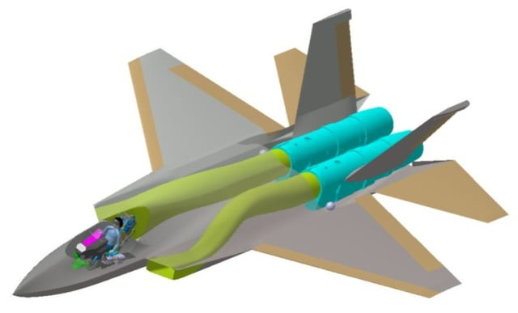
Square–Circle S-Duct in Fighter Jets
Better RCS Management (Stealth): A square or rectangular inlet creates planar surfaces that can be angled to reflect radar waves away from the source (not back to the radar). This is crucial for reducing radar cross-section (RCS). The curved S-duct further ensures the engine face (which is a huge radar reflector) is hidden, dramatically reducing the chance of radar detection.
Faceted Shape Compatibility: Stealth aircraft use faceted surfaces to scatter radar waves. A square or rectangular duct integrates better with the aircraft’s faceted body design than a round duct would.
Acceptable Trade-Off: Fighter jets can tolerate slightly lower pressure recovery or more flow distortion if it means a significant gain in stealth and maneuverability. Also, short missions and high thrust-to-weight ratios make this trade-off manageable.
Tighter Engine Integration: Square-to-circle transitions can be packed more efficiently within the compact airframe of a fighter jet, allowing for better internal volume usage and weight distribution.

Slide 9
Conclusions
We built an interactive web platform to compare the aerodynamic performance of different S-duct geometries using CFD data.
An AI-based predictor was added to estimate outlet velocity and pressure without needing repeated simulations.
Circle–circle S-ducts show better pressure recovery and flow stability, ideal for commercial aircraft.
Square–circle S-ducts help manage radar cross-section (RCS), enhancing stealth in fighter jets.
Our tool streamlines design evaluation, saving time and computational effort.

Slide 10
References
https://youtu.be/MJQVpvWBwXg?si=oycIkb3c4b41rUOZ
https://youtu.be/1woKtFjN-bE?si=bQ1waJTgeUwXjkoi
https://www.sciencedirect.com/science/article/abs/pii/S1270963816313517
https://en.wikipedia.org/wiki/S-duct
https://www.reddit.com/r/aviation/comments/eki2bk/ever_wondered_how_an_sduct_setup_looks_like_with/
https://www.reddit.com/r/WarplanePorn/comments/xsonox/sshaped_duct_of_kf21_boramaealbum/

Slide 11
Thank You

